Slide 1
Chapter 6 Special Numbers

Slide 2
Content
6.1 Stirling numbers
Stirling numbers of the second kind
Stirling numbers of the first kind
Basic Stirling number identifies
6.3 Harmonic numbers
6.4 Harmonic summation （选学）

Slide 3
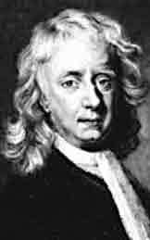
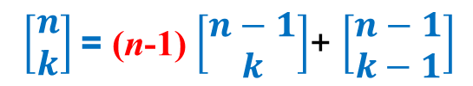
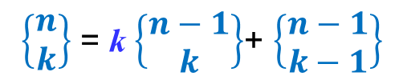
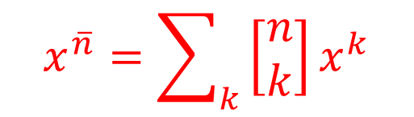
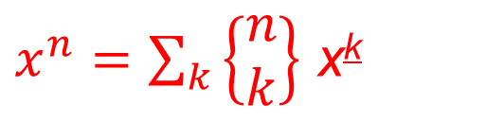
Stirling number
First introduce by Stirling as the coefficients in the expansions of the factorial to power and vise versa.
$x^{n}=\sum_{k}{\left\{\begin{aligned}n \\ k\end{aligned}\right\}}$ x^{k}
$$x^{\overline{n}}=\sum_{k}{\left[\begin{aligned}n \\ k\end{aligned}\right]x^{k}}$$
Recurrence relation found by Lagrange
$\left\{\begin{aligned}n \\ k\end{aligned}\right\}$ = k $\left\{\begin{aligned}n−1 \\ k\end{aligned}\right\}$+ $\left\{\begin{aligned}n−1 \\ k−1\end{aligned}\right\}$
$\left[\begin{aligned}n \\ k\end{aligned}\right]$= (n-1) $\left[\begin{aligned}n−1 \\ k\end{aligned}\right]$+ $\left[\begin{aligned}n−1 \\ k−1\end{aligned}\right]$
It is related to some combinatorial problems
James Stirling
Scottish mathematician

Slide 4
Content
6.1 Stirling numbers
Stirling numbers of the second kind
Stirling numbers of the first kind
Basic Stirling number identifies
6.3 Harmonic numbers
6.4 Harmonic summation （选学）

Slide 5
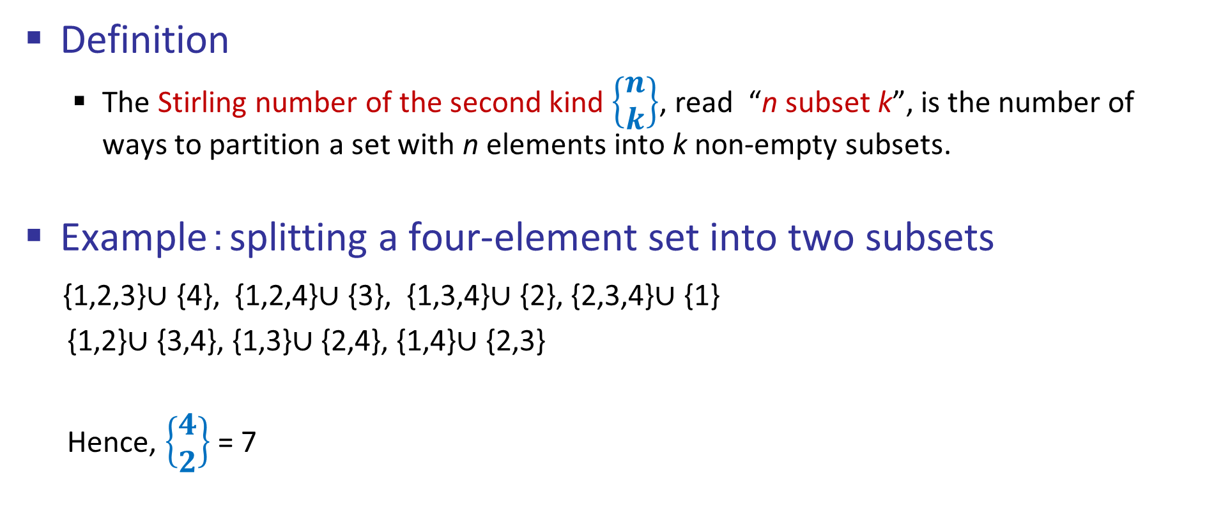
Stirling number of second kind (第二类斯特林数)
Definition
The Stirling number of the second kind $\left\{\begin{aligned}n \\ k\end{aligned}\right\}$, read “n subset k”, is the number of ways to partition a set with n elements into k non-empty subsets.
Example：splitting a four-element set into two subsets
{1,2,3}$∪$ {4}, {1,2,4}$∪$ {3}, {1,3,4}$∪$ {2}, {2,3,4}$∪$ {1}
{1,2}$∪$ {3,4}, {1,3}$∪$ {2,4}, {1,4}$∪$ {2,3}
Hence, $\left\{\begin{aligned}4 \\ 2\end{aligned}\right\}$ = 7

Slide 6
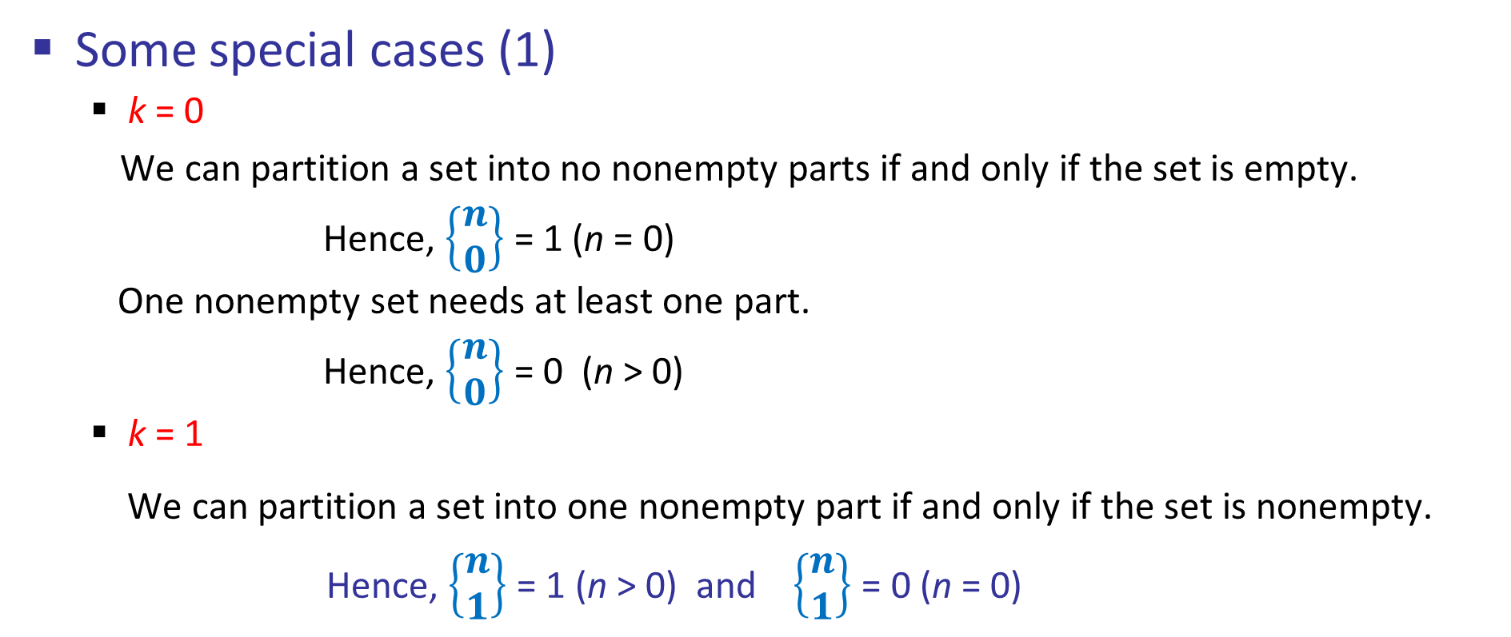
Stirling number of second kind (第二类斯特林数)
Some special cases (1)
k = 0
We can partition a set into no nonempty parts if and only if the set is empty.
Hence, $\left\{\begin{aligned}n \\ 0\end{aligned}\right\}$ = 1 (n = 0)
One nonempty set needs at least one part.
Hence, $\left\{\begin{aligned}n \\ 0\end{aligned}\right\}$ = 0 (n > 0)
k = 1
We can partition a set into one nonempty part if and only if the set is nonempty.
Hence, $\left\{\begin{aligned}n \\ 1\end{aligned}\right\}$ = 1 (n > 0) and $\left\{\begin{aligned}n \\ 1\end{aligned}\right\}$ = 0 (n = 0)

Slide 7
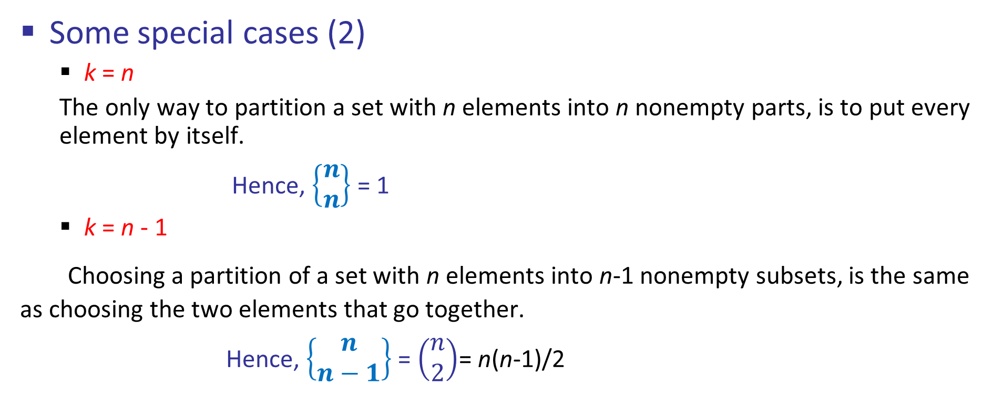
Stirling number of second kind (第二类斯特林数)
Some special cases (2)
k = n
The only way to partition a set with n elements into n nonempty parts, is to put every element by itself.
Hence, $\left\{\begin{aligned}n \\ n\end{aligned}\right\}$ = 1
k = n - 1
Choosing a partition of a set with n elements into n-1 nonempty subsets, is the same as choosing the two elements that go together.
Hence, $\left\{\begin{aligned}n \\ n−1\end{aligned}\right\}$ = $\left(\begin{aligned}n \\ 2\end{aligned}\right)$= n(n-1)/2

Slide 8
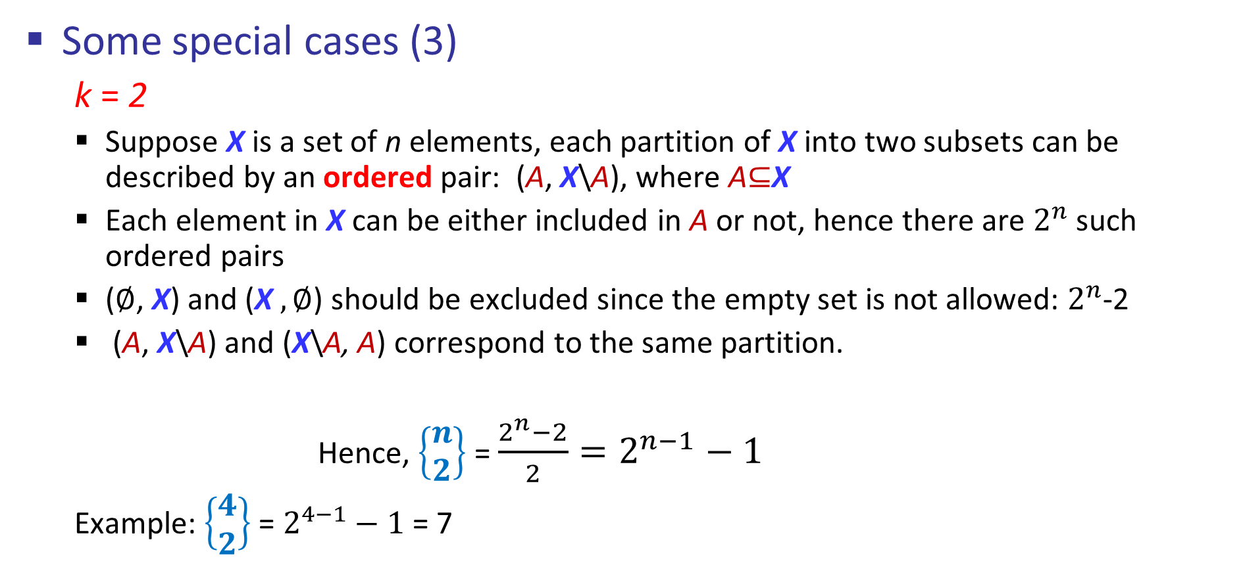
Stirling number of second kind (第二类斯特林数)
Some special cases (3)
k = 2
Suppose X is a set of n elements, each partition of X into two subsets can be described by an ordered pair: (A, X\A), where A$⊆$X
Each element in X can be either included in A or not, hence there are $2^{n}$ such ordered pairs
($∅$, X) and (X $,∅$) should be excluded since the empty set is not allowed: $2^{n}$-2
(A, X\A) and (X\A, A) correspond to the same partition.
Hence, $\left\{\begin{aligned}n \\ 2\end{aligned}\right\}$ = $\frac{2^{n}−2}{2}=2^{n−1}−1$
Example: $\left\{\begin{aligned}4 \\ 2\end{aligned}\right\}$ = $2^{4−1}−1$ = 7

Slide 9
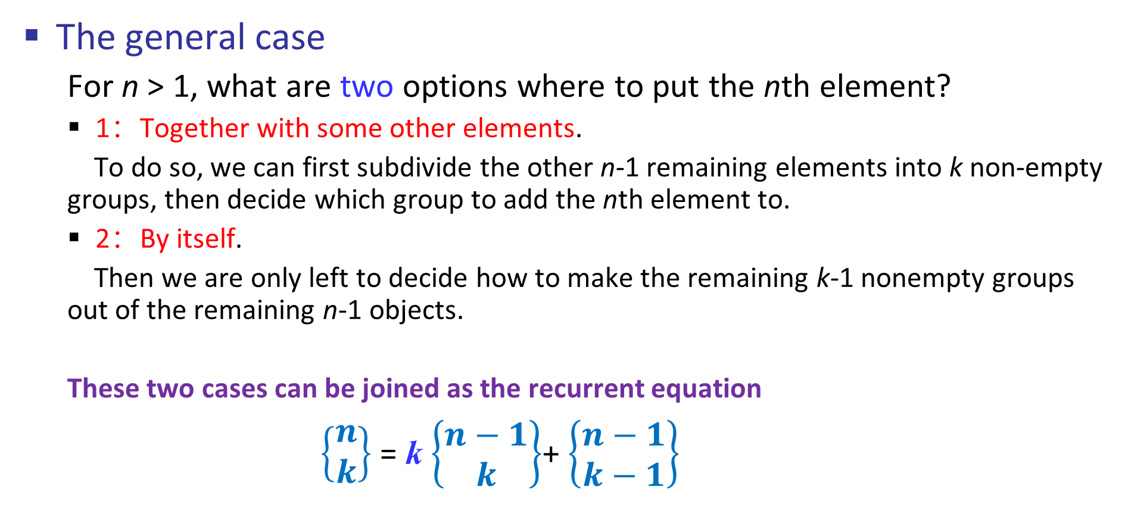
Stirling number of second kind (第二类斯特林数)
The general case
For n > 1, what are two options where to put the nth element?
1：Together with some other elements.
To do so, we can first subdivide the other n-1 remaining elements into k non-empty groups, then decide which group to add the nth element to.
2：By itself.
Then we are only left to decide how to make the remaining k-1 nonempty groups out of the remaining n-1 objects.
These two cases can be joined as the recurrent equation
$\left\{\begin{aligned}n \\ k\end{aligned}\right\}$ = k $\left\{\begin{aligned}n−1 \\ k\end{aligned}\right\}$+ $\left\{\begin{aligned}n−1 \\ k−1\end{aligned}\right\}$
Notes:
demo

Slide 10
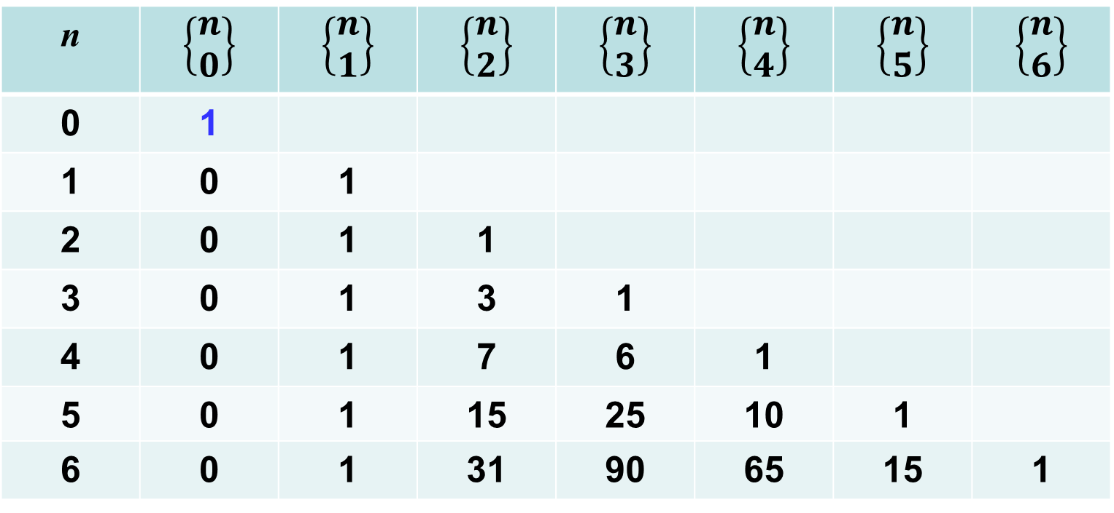
Stirling number of second kind (第二类斯特林数)
n | $$\left\{\begin{aligned}n \\ 0\end{aligned}\right\}$$ | $$\left\{\begin{aligned}n \\ 1\end{aligned}\right\}$$ | $$\left\{\begin{aligned}n \\ 2\end{aligned}\right\}$$ | $$\left\{\begin{aligned}n \\ 3\end{aligned}\right\}$$ | $$\left\{\begin{aligned}n \\ 4\end{aligned}\right\}$$ | $$\left\{\begin{aligned}n \\ 5\end{aligned}\right\}$$ | $$\left\{\begin{aligned}n \\ 6\end{aligned}\right\}$$
0 | 1
1 | 0 | 1
2 | 0 | 1 | 1
3 | 0 | 1 | 3 | 1
4 | 0 | 1 | 7 | 6 | 1
5 | 0 | 1 | 15 | 25 | 10 | 1
6 | 0 | 1 | 31 | 90 | 65 | 15 | 1
+
×
3

Slide 11
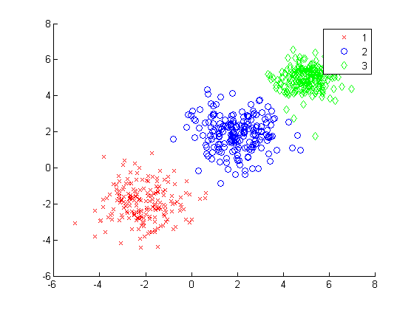
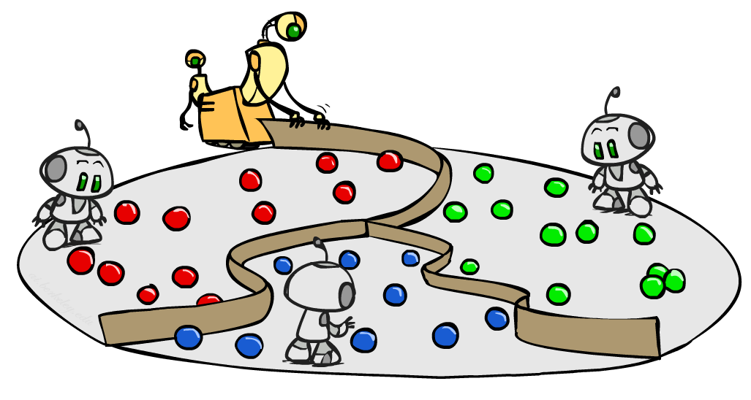
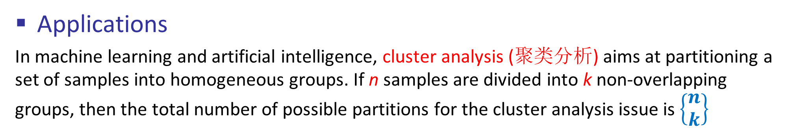
Stirling number of second kind (第二类斯特林数)
Applications
In machine learning and artificial intelligence, cluster analysis (聚类分析) aims at partitioning a set of samples into homogeneous groups. If n samples are divided into k non-overlapping groups, then the total number of possible partitions for the cluster analysis issue is $\left\{\begin{aligned}n \\ k\end{aligned}\right\}$

Slide 12

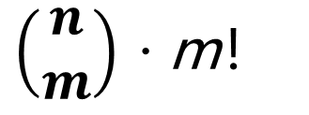
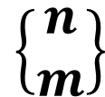
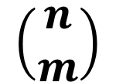
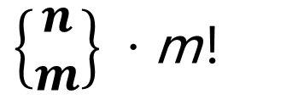
单选题
1分
1. n个不同的球，放入m个有区别的盒子，不允许盒子为空，共有（ ）种方案。
A
$$\left\{\begin{aligned}n \\ m\end{aligned}\right\}$$
B
$\left\{\begin{aligned}n \\ m\end{aligned}\right\}$ · m！
C
$$\left(\begin{aligned}n \\ m\end{aligned}\right)$$
D
$\left(\begin{aligned}n \\ m\end{aligned}\right)$ · m！
提交

Slide 13
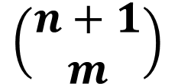
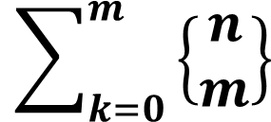
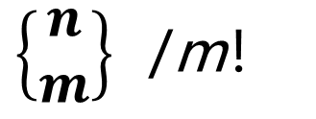
单选题
1分
2. n个不同的球，放入m个无区别的盒子，允许盒子为空，共有（ ）种方案。
A
$$\left\{\begin{aligned}n \\ m\end{aligned}\right\}$$
B
$\left\{\begin{aligned}n \\ m\end{aligned}\right\}$ /m！
C
$$\sum_{k=0}^{m}{\left\{\begin{aligned}n \\ m\end{aligned}\right\}}$$
D
$\left(\begin{aligned}n+1 \\ m\end{aligned}\right)$
提交

Slide 14
Content
6.1 Stirling numbers
Stirling numbers of the second kind
Stirling numbers of the first kind
Basic Stirling number identifies
6.3 Harmonic numbers
6.4 Harmonic summation （选学）

Slide 15
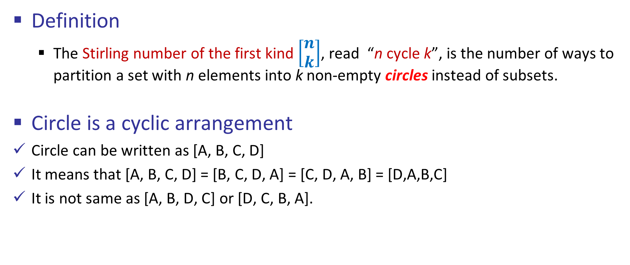
Stirling number of first kind (第一类斯特林数)
Definition
The Stirling number of the first kind $\left[\begin{aligned}n \\ k\end{aligned}\right]$, read “n cycle k”, is the number of ways to partition a set with n elements into k non-empty circles instead of subsets.
Circle is a cyclic arrangement
Circle can be written as [A, B, C, D]
It means that [A, B, C, D] = [B, C, D, A] = [C, D, A, B] = [D,A,B,C]
It is not same as [A, B, D, C] or [D, C, B, A].
A
D
B
C

Slide 16
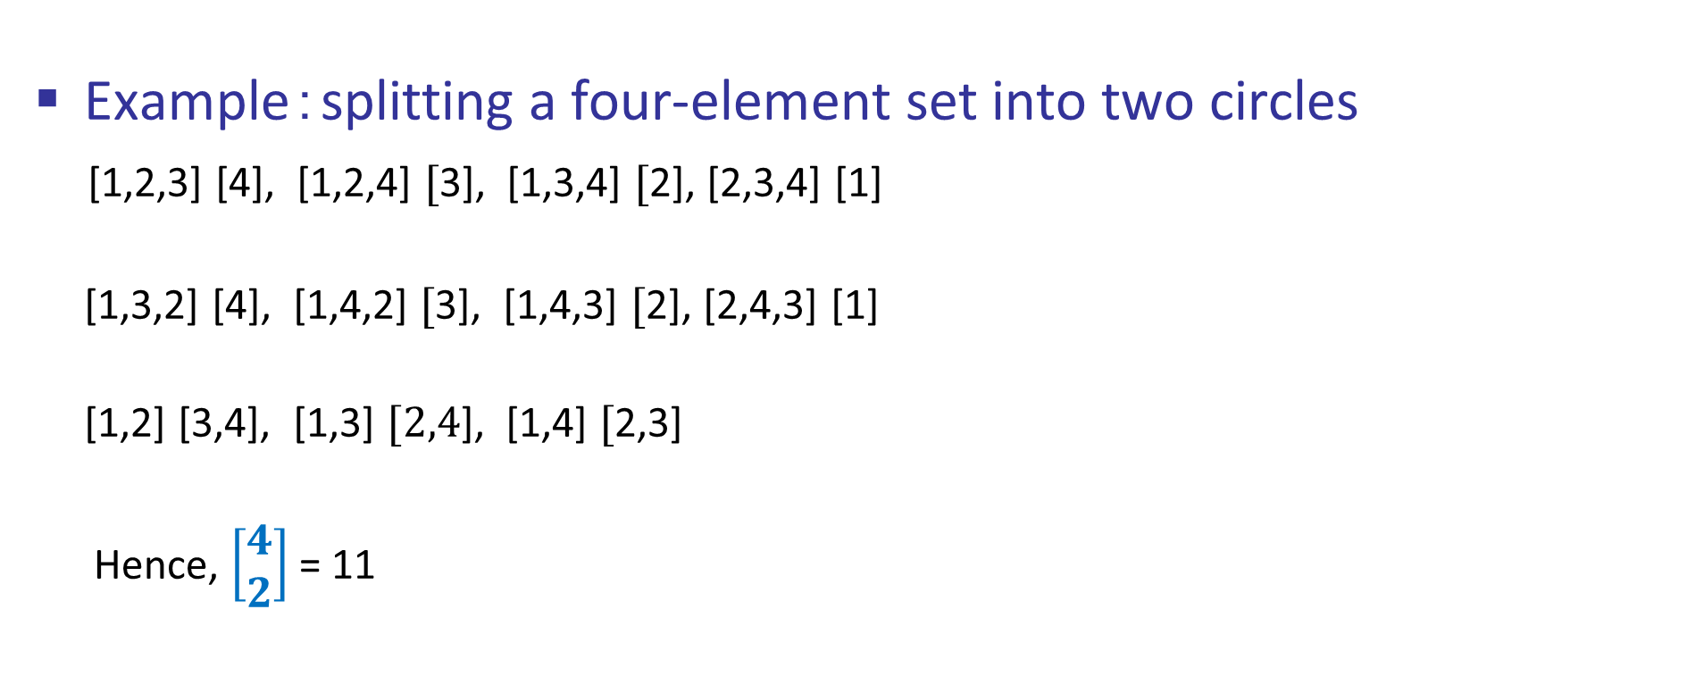
Stirling number of first kind (第一类斯特林数)
Example：splitting a four-element set into two circles
[1,2,3] [4], [1,2,4] $[$3], [1,3,4] $[$2], [2,3,4] [1]
[1,3,2] [4], [1,4,2] $[$3], [1,4,3] $[$2], [2,4,3] [1]
[1,2] [3,4], [1,3] $[2,4$], [1,4] $[$2,3]
Hence, $\left[\begin{aligned}4 \\ 2\end{aligned}\right]$= 11

Slide 17
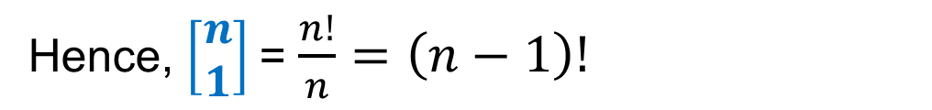
Stirling number of first kind (第一类斯特林数)
Some special cases (1)
k = 1
To arrange one circle of n objects:
(1) There are n! permutations
(2) Each cycle corresponds to n of them because any one of its elements can be listed 1st.
Hence, $\left[\begin{aligned}n \\ 1\end{aligned}\right]$= $\frac{n!}{n}=\left(n−1\right)!$

Slide 18
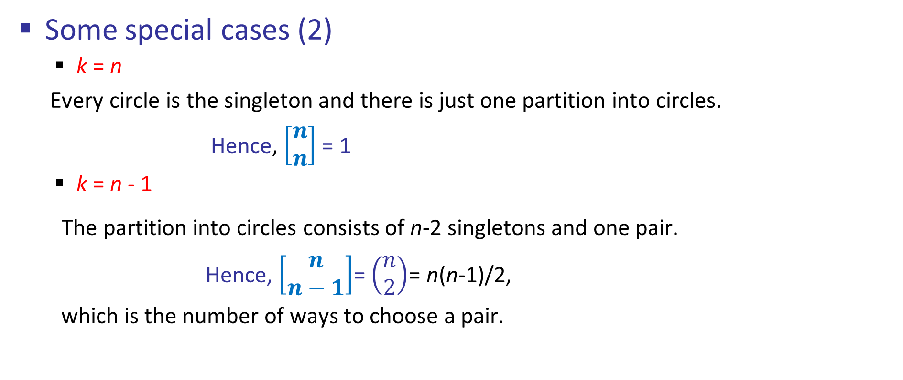
Stirling number of first kind (第一类斯特林数)
Some special cases (2)
k = n
Every circle is the singleton and there is just one partition into circles.
Hence, $\left[\begin{aligned}n \\ n\end{aligned}\right]$= 1
k = n - 1
The partition into circles consists of n-2 singletons and one pair.
Hence, $\left[\begin{aligned}n \\ n−1\end{aligned}\right]$= $\left(\begin{aligned}n \\ 2\end{aligned}\right)$= n(n-1)/2,
which is the number of ways to choose a pair.

Slide 19
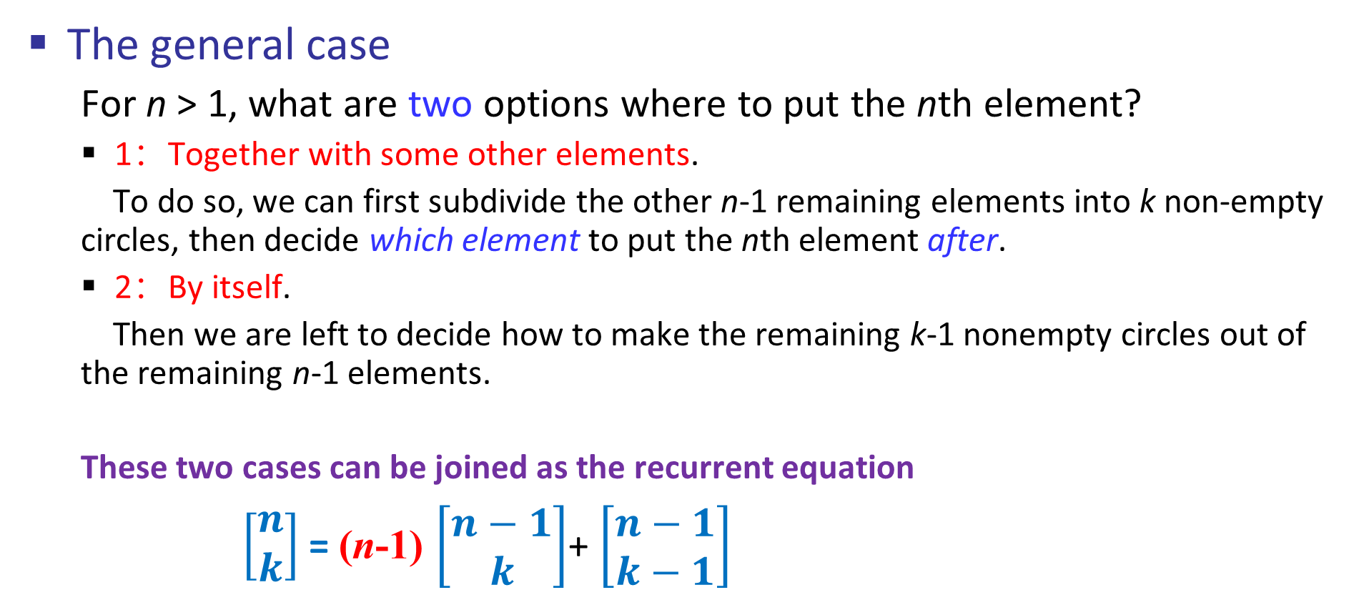
Stirling number of first kind (第一类斯特林数)
The general case
For n > 1, what are two options where to put the nth element?
1：Together with some other elements.
To do so, we can first subdivide the other n-1 remaining elements into k non-empty circles, then decide which element to put the nth element after.
2：By itself.
Then we are left to decide how to make the remaining k-1 nonempty circles out of the remaining n-1 elements.
These two cases can be joined as the recurrent equation
$\left[\begin{aligned}n \\ k\end{aligned}\right]$= (n-1) $\left[\begin{aligned}n−1 \\ k\end{aligned}\right]$+ $\left[\begin{aligned}n−1 \\ k−1\end{aligned}\right]$

Slide 20
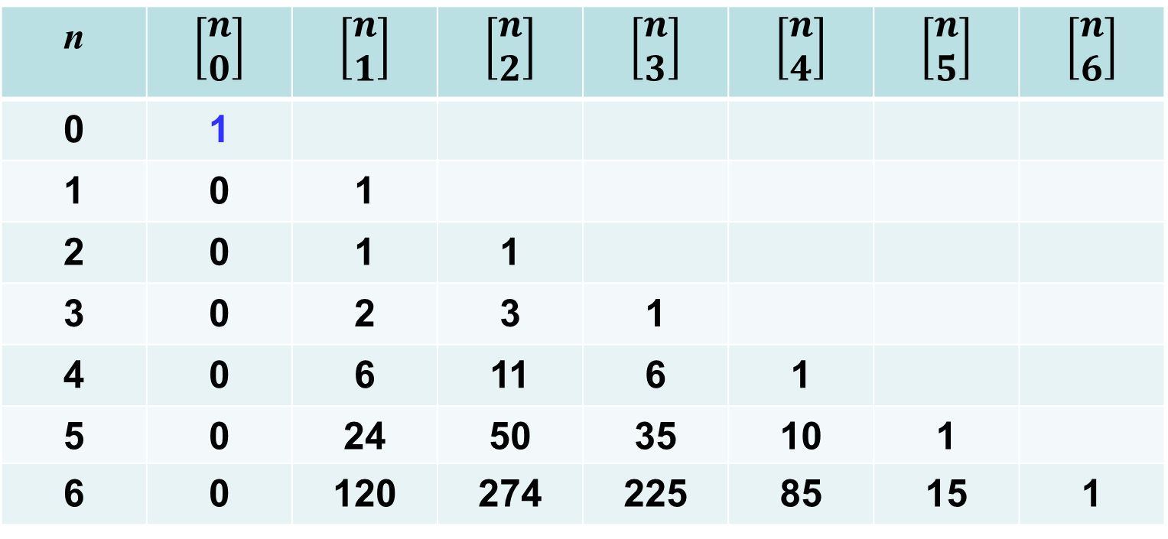
Stirling number of first kind (第一类斯特林数)
n | $$\left[\begin{aligned}n \\ 0\end{aligned}\right]$$ | $$\left[\begin{aligned}n \\ 1\end{aligned}\right]$$ | $$\left[\begin{aligned}n \\ 2\end{aligned}\right]$$ | $$\left[\begin{aligned}n \\ 3\end{aligned}\right]$$ | $$\left[\begin{aligned}n \\ 4\end{aligned}\right]$$ | $$\left[\begin{aligned}n \\ 5\end{aligned}\right]$$ | $$\left[\begin{aligned}n \\ 6\end{aligned}\right]$$
0 | 1
1 | 0 | 1
2 | 0 | 1 | 1
3 | 0 | 2 | 3 | 1
4 | 0 | 6 | 11 | 6 | 1
5 | 0 | 24 | 50 | 35 | 10 | 1
6 | 0 | 120 | 274 | 225 | 85 | 15 | 1
+
×
4

Slide 21
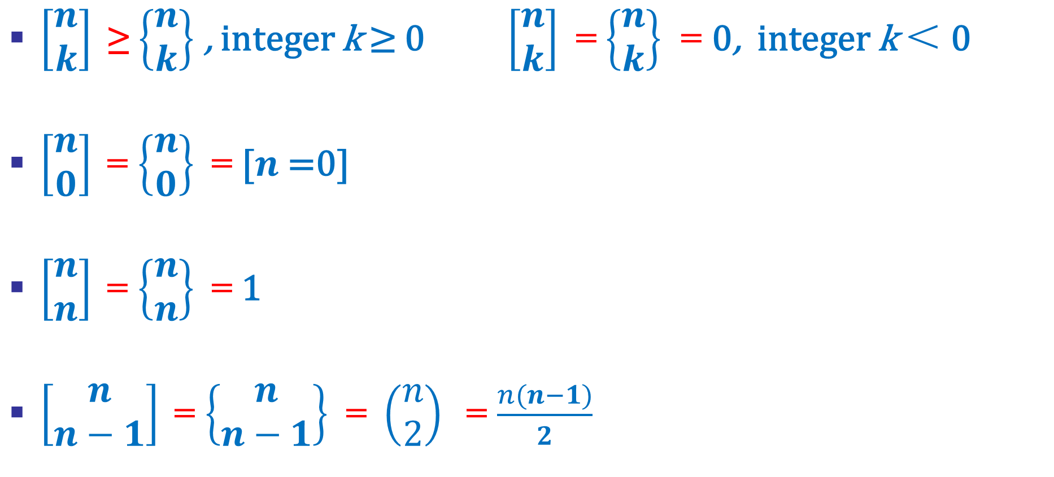
Stirling number of first kind (第一类斯特林数)
$\left[\begin{aligned}n \\ k\end{aligned}\right]$≥ $\left\{\begin{aligned}n \\ k\end{aligned}\right\}$ , integer k ≥ 0 $\left[\begin{aligned}n \\ k\end{aligned}\right]$= $\left\{\begin{aligned}n \\ k\end{aligned}\right\}$ = 0, integer k ＜ 0
$\left[\begin{aligned}n \\ 0\end{aligned}\right] \text{=}$ $\left\{\begin{aligned}n \\ 0\end{aligned}\right\}$ = [$n$=0]
$\left[\begin{aligned}n \\ n\end{aligned}\right] \text{=}$ $\left\{\begin{aligned}n \\ n\end{aligned}\right\}$ = 1
$\left[\begin{aligned}n \\ n−1\end{aligned}\right] \text{=}$ $\left\{\begin{aligned}n \\ n−1\end{aligned}\right\}$ = $\left(\begin{aligned}n \\ 2\end{aligned}\right)$ = $\frac{n(n−1)}{2}$

Slide 22
Content
6.1 Stirling numbers
Stirling numbers of the second kind
Stirling numbers of the first kind
Basic Stirling number identifies
6.3 Harmonic numbers
6.4 Harmonic summation （选学）

Slide 23
Basic Stirling number identities
Each permutation is equivalent to a set of cycles
For any integer $n≥0$, $\sum_{k=0}^{n}{\left[\begin{aligned}n \\ k\end{aligned}\right]=n!}$
1
2
3
4
5
6
7
8
9
3
8
4
7
2
9
1
5
6
Thus, the permutation 384729156 is equivalent to the cycle arrangement
[1,3,4,7] [2,8,5] [6,9]

Slide 24
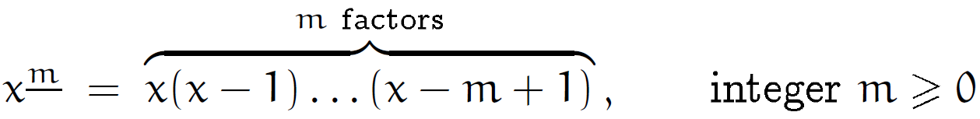
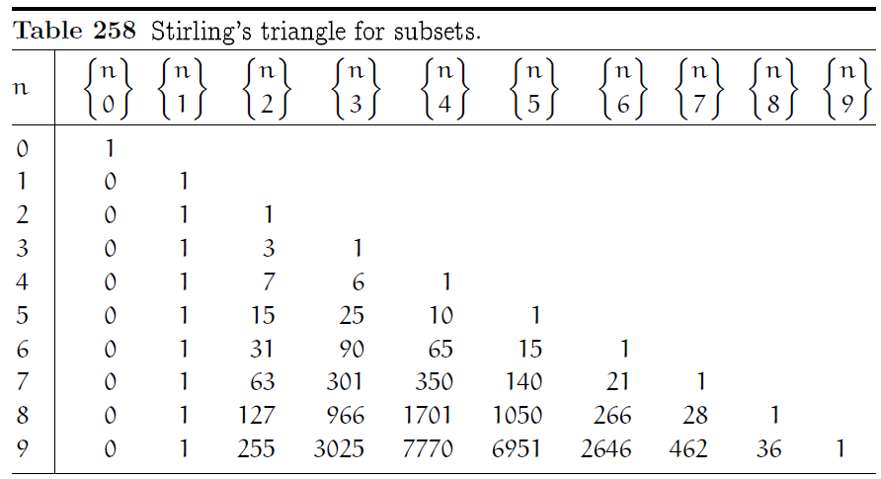
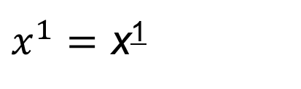
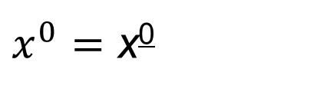
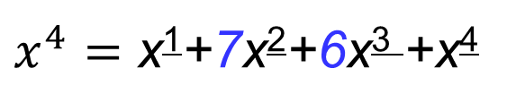
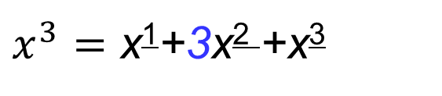
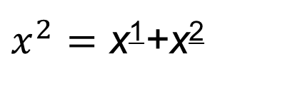
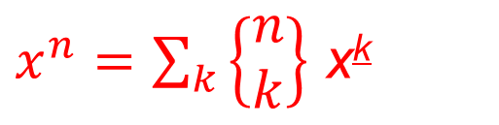
Basic Stirling number identities
Observation
$x^{0}=$ x⁰
$x^{1}=$ x¹
$x^{2}=$ x¹+x²
$x^{3}=$ x¹+3x² +x³
$x^{4}=$ x¹+7x²+6x³ +x⁴
……………..
Does the following general formula hold?
$x^{n}=\sum_{k}{\left\{\begin{aligned}n \\ k\end{aligned}\right\}}$ x^{k}

Slide 25
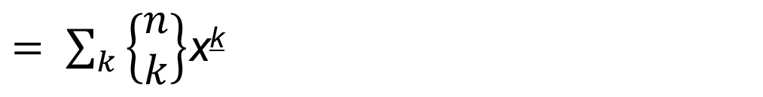
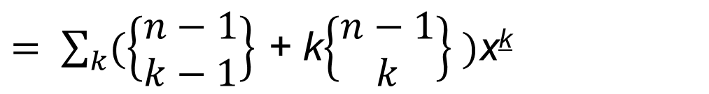
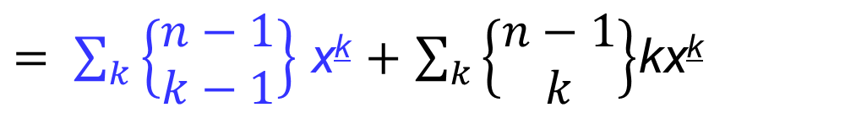
Basic Stirling number identities
Inductive proof of $x^{n}=\sum_{k}{\left\{\begin{aligned}n \\ k\end{aligned}\right\}}$ x^{k}
Since x^{k+1}= x^{k}(x-k), we have x^{k}x= x^{k+1}+ kx^{k}
Hence
${x∙x}^{n−1}=$ $x∙\sum_{k}{\left\{\begin{aligned}n−1 \\ k\end{aligned}\right\}}$ x^{k} $=$ $\sum_{k}{\left\{\begin{aligned}n−1 \\ k\end{aligned}\right\}}$ x^{k+1} $+$ $\sum_{k}{\left\{\begin{aligned}n−1 \\ k\end{aligned}\right\}}$kx^{k}
$= \sum_{k}{\left\{\begin{aligned}n−1 \\ k−1\end{aligned}\right\}}$ x^{k} $+$ $\sum_{k}{\left\{\begin{aligned}n−1 \\ k\end{aligned}\right\}}$kx^{k}
// 下标变换： k→ k-1
$= \sum_{k}{(\left\{\begin{aligned}n−1 \\ k−1\end{aligned}\right\}}$ + k$\left\{\begin{aligned}n−1 \\ k\end{aligned}\right\} )$x^{k}
//$\left\{\begin{aligned}n \\ k\end{aligned}\right\}$=k$\left\{\begin{aligned}n−1 \\ k\end{aligned}\right\}$+ $\left\{\begin{aligned}n−1 \\ k−1\end{aligned}\right\}$
$= \sum_{k}{\left\{\begin{aligned}n \\ k\end{aligned}\right\}}$x^{k}

Slide 26
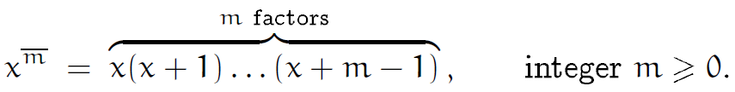
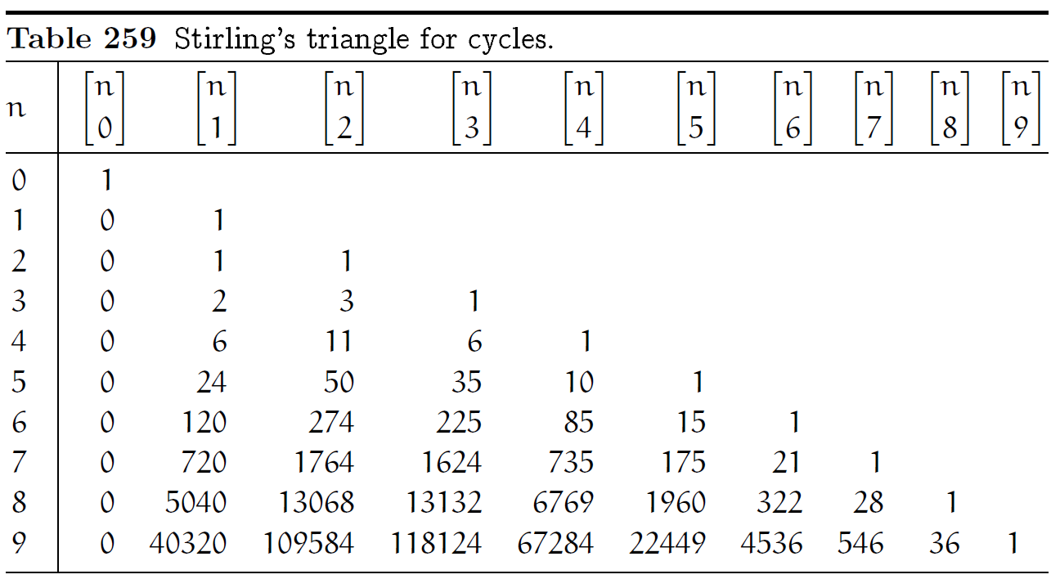





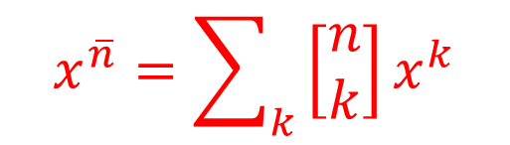
Basic Stirling number identities
Observation
$$x^{\overline{0}}=x^{0}$$
$$x^{\overline{1}}=x^{1}$$
$$x^{\overline{2}}=x^{2}+x^{1}$$
$$x^{\overline{3}}=x^{3}+{3x}^{2}+{2x}^{1}$$
$$x^{\overline{4}}=x^{4}+{6x}^{3}+{11x}^{2}+{6x}^{1}$$
……………..
Does the following general formula hold?
$$x^{\overline{n}}=\sum_{k}{\left[\begin{aligned}n \\ k\end{aligned}\right]x^{k}}$$

Slide 27
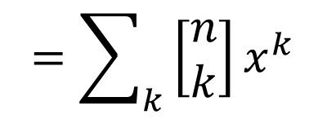

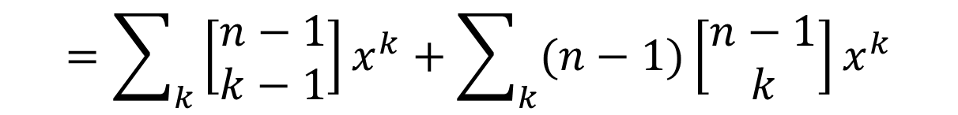
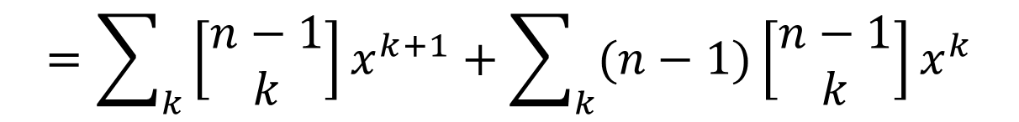

Basic Stirling number identities
Inductive proof of $x^{\overline{n}}=\sum_{k}{\left[\begin{aligned}n \\ k\end{aligned}\right]x^{k}}$
$$x^{\overline{n}}={(x+n−1)x}^{\overline{n−1}}=(x+n−1)\sum_{k}{\left[\begin{aligned}n−1 \\ k\end{aligned}\right]x^{k}}$$
$$=\sum_{k}{\left[\begin{aligned}n−1 \\ k\end{aligned}\right]x^{k+1}+\sum_{k}{(n−1)\left[\begin{aligned}n−1 \\ k\end{aligned}\right]x^{k}}}$$
$$=\sum_{k}{\left[\begin{aligned}n−1 \\ k−1\end{aligned}\right]x^{k}+\sum_{k}{(n−1)\left[\begin{aligned}n−1 \\ k\end{aligned}\right]x^{k}}}$$
// 下标变换： k→ k-1
$$=\sum_{k}{(\left[\begin{aligned}n−1 \\ k−1\end{aligned}\right]+(n−1)\left[\begin{aligned}n−1 \\ k\end{aligned}\right]{)x}^{k}}$$
//$\left[\begin{aligned}n \\ k\end{aligned}\right]$=(n-1)$\left[\begin{aligned}n−1 \\ k\end{aligned}\right]$+ $\left[\begin{aligned}n−1 \\ k−1\end{aligned}\right]$
$$=\sum_{k}{\left[\begin{aligned}n \\ k\end{aligned}\right]x^{k}}$$

Slide 28
作业
6.1，6.2，6.32

Slide 29
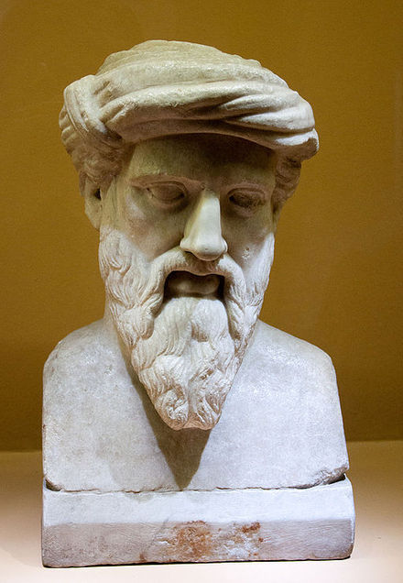
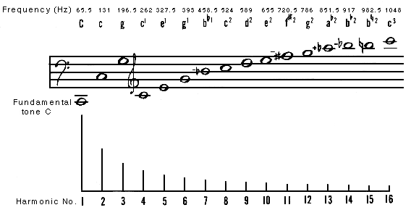
Harmonic number
Pythagoras noticed the sounds the anvils made were harmonious.
The divergence of the harmonic series was first proven by Nicole Oresme,but this achievement fell into obscurity. Proofs were by Pietro Mengoli, Johann Bernoulli,and Jacob Bernoulli.
Pythagoras
Greek mathematician

Slide 30

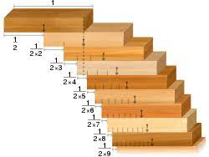
Harmonic number
It is related to some architectures in the age of Baroque.

Slide 31
Content
6.1 Stirling numbers
Stirling numbers of the second kind
Stirling numbers of the first kind
Basic Stirling number identifies
6.3 Harmonic numbers
6.4 Harmonic summation （选学）

Slide 32
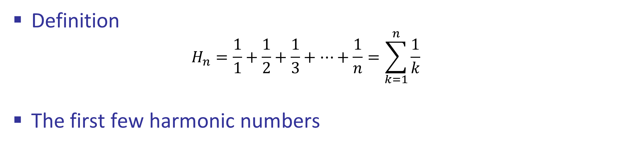
Harmonic Numbers (调和数)
Definition
$$H_{n}=\frac{1}{1}+\frac{1}{2}+\frac{1}{3}+…+\frac{1}{n}=\sum_{k=1}^{n}{\frac{1}{k}}$$
The first few harmonic numbers
n | 0 | 1 | 2 | 3 | 4 | 5 | 6 | 7 | 8 | 9 | 10
H_{n} | 0 | 1 | 3/2 | 11/6 | 15/12 | 137/60 | 49/20 | 363/140 | 761/280 | 7129/2520 | 7381/2520

Slide 33

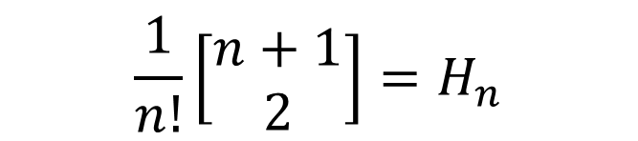



Harmonic Numbers (调和数)
A closed-form formula for $\left[\begin{aligned}n+1 \\ 2\end{aligned}\right]$
$\left[\begin{aligned}n+1 \\ 2\end{aligned}\right]=n\left[\begin{aligned}n \\ 2\end{aligned}\right]$+ $\left[\begin{aligned}n \\ 1\end{aligned}\right]$
$=n\left[\begin{aligned}n \\ 2\end{aligned}\right]+(n−1)!$
$\frac{1}{n!}\left[\begin{aligned}n+1 \\ 2\end{aligned}\right]=\frac{1}{(n−1)!}\left[\begin{aligned}n \\ 2\end{aligned}\right]$+ $\frac{1}{n}$
$$\frac{1}{n!}\left[\begin{aligned}n+1 \\ 2\end{aligned}\right]=H_{n}$$
$$\left[\begin{aligned}n+1 \\ 2\end{aligned}\right]={n!H}_{n}$$

Slide 34

Harmonic Numbers (调和数)
The divergence of Harmonic series: $\lim_{n→∞}{H_{n}=∞}$
Group Harmonic numbers according to powers of 2
$$\frac{1}{1} + \frac{1}{2}+\frac{1}{3} + \frac{1}{4}+\frac{1}{5}+\frac{1}{6}+\frac{1}{7} + \frac{1}{8}+\frac{1}{9}+\frac{1}{10}+\frac{1}{11}+\frac{1}{12}+\frac{1}{13}+\frac{1}{14}+\frac{1}{15} +…$$
group 1
group 2
group 3
group 4
The sum of each group is between $\frac{2^{(k−1)}}{2^{k} −1}>\frac{1}{2}$and $\frac{2^{(k−1)}}{2^{(k−1)}}=1,$ k is group number, there are $2^{(k−1)}$ terms in group k.
If n is in group k, then ${k/2<H}_{n}≤k.$Hence, $\lim_{n→∞}{H_{n}=∞}.$
More precisely, ($\left\lfloor lg n\right\rfloor {+1)/2<H}_{n}≤\left\lfloor lg n\right\rfloor +1.$

Slide 35





Harmonic Numbers (调和数)
Tighter bounds on $H_{n}:\ln{n<H_{n}<\ln{n}+1}$
$$\int_{1}^{n}{\frac{1}{x}dx}=\ln{n}<\sum_{k=1}^{n}{\frac{1}{k}}=H_{n}$$
$$\ln{n<H_{n}<\ln{n}+1}$$
1+$\int_{1}^{n}{\frac{1}{x}dx}=\text{1+}ln{n}>\sum_{k=1}^{n}{\frac{1}{k}}=H_{n}$

Slide 36

Harmonic Numbers (调和数)
High-order Harmonic number: $H_{n}^{\left(r\right)}=\sum_{k=1}^{n}{\frac{1}{k^{r}}}$
Example: Second-order Harmonic number: $H_{n}^{\left(2\right)}=\sum_{k=1}^{n}{\frac{1}{k^{2}}}$
If r >1, then these numbers approach a limit as $n→∞$
This limit is conventionally called Riemann's zeta function

Slide 37









Harmonic Numbers (调和数)
The approximation of $H_{n}^{\left(1\right)}$based on genialized Harmonic number
$$=ln\left(\frac{k}{k−1}\right)$$
$$=ln\left(\frac{1}{1−1/k}\right)$$
$$={−\ln\left(1+(−\frac{1}{k})\right)}$$
$\ln{k−\ln\left(k−1\right)}$
=$\ln{1−\ln\left(1−1/k\right)}$
$$=−\left(−\frac{1}{k}−\frac{{\left(−\frac{1}{k}\right)}^{2}}{2}+\frac{{\left(−\frac{1}{k}\right)}^{3}}{3}−\frac{{\left(−\frac{1}{k}\right)}^{4}}{4}+…\right)$$
$$=\frac{1}{k}+\frac{1}{2k^{2}}+\frac{1}{3k^{3}}+\frac{1}{4k^{4}}+…$$
$$\ln{n−\ln{1}}=\sum_{k=2}^{n}{\left(\frac{1}{k}+\frac{1}{2k^{2}}+\frac{1}{3k^{3}}+\frac{1}{4k^{4}}+…\right)}$$
If sum both side from 2 to n, then
$$={(H}_{n}−1)+1/2(H_{n}^{\left(2\right)}−1)+1/3(H_{n}^{\left(3\right)}−1)+…$$

Slide 38




Harmonic Numbers (调和数)
The approximation of $H_{n}^{\left(1\right)}$based on genialized Harmonic number (cont.)
$$H_{n}−\ln{n}=1−\frac{1}{2}{(H}_{n}^{\left(2\right)}−1)−\frac{1}{3}{(H}_{n}^{\left(3\right)}−1)−…$$
When $n→∞$
$$\lim_{n→∞}{{(H}_{n}−\ln{n)}=}γ=$$
$γ=\text{0.577215664}9…$, is called the Euler’s constant.
Furthermore, we have
Example:
$$H_{1000000}≈14.3927267228657236313811275$$

Slide 39
作业
6.4，6.20, 6.39

Slide 40
Content
6.1 Stirling numbers
Stirling numbers of the second kind
Stirling numbers of the first kind
Basic Stirling number identifies
6.3 Harmonic numbers
6.4 Harmonic summation （选学）

Slide 41



Harmonic summation
Two sums involving Harmonic numbers
$$\sum_{0≤k<n}{H_{k}=}nH_{n}−n$$
(2.36)
$$\sum_{0≤k<n}{{kH}_{k}=}\frac{n(n−1)}{2}H_{n}−\frac{n(n−1)}{4}$$
(2.57)
$$\sum_{0≤k<n}{\left(\begin{aligned}k \\ m\end{aligned}\right)H_{n}}$$
A more generalized sum
If m=0, (2.36); if m=1, (2.57)

Slide 42

Harmonic summation
We still use summation by parts (分部求和法)
$$\sum_{a}^{b}{u\left(x\right)∆v\left(x\right)δx=u\left(x\right)v(x)|_{a}^{b}}−\sum_{a}^{b}{v\left(x+1\right)∆u\left(x\right)δx}$$

Slide 43





Harmonic summation
The use of summation by parts for $\sum_{0≤k<n}{\left(\begin{aligned}k \\ m\end{aligned}\right)H_{n}}$
$$u\left(k\right)=H_{k}$$
$$∆u\left(k\right)=H_{k+1}−H_{k}$$
$$v\left(k\right)=\left(\begin{aligned}k \\ m+1\end{aligned}\right)$$
$$∆v\left(k\right)=\left(\begin{aligned}k+1 \\ m+1\end{aligned}\right)−\left(\begin{aligned}k \\ m+1\end{aligned}\right)=\left(\begin{aligned}k \\ m\end{aligned}\right)$$
Then we can plug these terms into the equation below
$$\sum_{a}^{b}{u\left(x\right)∆v\left(x\right)δx=u\left(x\right)v(x)|_{a}^{b}}−\sum_{a}^{b}{v\left(x+1\right)∆u\left(x\right)δx}$$
Notes:
demo

Slide 44










Harmonic summation
The use of summation by parts for $\sum_{0≤k<n}{\left(\begin{aligned}k \\ m\end{aligned}\right)H_{n}}$
$$\sum_{0≤k<n}{\left(\begin{aligned}k \\ m\end{aligned}\right)H_{n}}$$
$$=\sum_{0}^{n}{\left(\begin{aligned}x \\ m\end{aligned}\right)H_{x}δx}$$
$$=\left(\begin{aligned}x \\ m+1\end{aligned}\right)H_{x}|_{0}^{n}−\sum_{0}^{n}{\left(\begin{aligned}x+1 \\ m+1\end{aligned}\right)\frac{1}{x+1}δx}$$
$$=\left(\begin{aligned}n \\ m+1\end{aligned}\right)H_{n}−\sum_{0≤k<n}{\left(\begin{aligned}k+1 \\ m+1\end{aligned}\right)\frac{1}{k+1}}$$
$$=\left(\begin{aligned}n \\ m+1\end{aligned}\right)H_{n}−\sum_{0≤k<n}{\frac{k+1}{m+1}\left(\begin{aligned}k \\ m\end{aligned}\right)\frac{1}{k+1}}$$
$$=\left(\begin{aligned}n \\ m+1\end{aligned}\right)H_{n}−\sum_{0≤k<n}{\left(\begin{aligned}k \\ m\end{aligned}\right)\frac{1}{m+1}}$$
$$=\left(\begin{aligned}n \\ m+1\end{aligned}\right)H_{n}−\left(\begin{aligned}n \\ m+1\end{aligned}\right)\frac{1}{m+1}$$
$$=\left(\begin{aligned}n \\ m+1\end{aligned}\right){(H}_{n}−\frac{1}{m+1})$$

Slide 45






Harmonic summation
Example 2: $S_{n}=\sum_{k=1}^{n}{\frac{H_{k}}{k}}$
Expanding $H_{k}$by its definition, we have
$$S_{n}=\sum_{k=1}^{n}{\frac{H_{k}}{k}}=\sum_{1≤j≤k≤n}{\frac{1}{j∙k}}$$
$$=\frac{1}{2}\left({(\sum_{k=1}^{n}{\frac{1}{k}})}^{2}+\sum_{k=1}^{n}{\frac{1}{k^{2}}}\right)$$
$$=\frac{1}{2}\left(H_{n}^{2}+H_{n}^{(2)}\right)$$

Slide 46

Harmonic summation
Example 3: $U_{n}=\sum_{k≥1}{\left(\begin{aligned}n \\ k\end{aligned}\right)\frac{{\left(−1\right)}^{k−1}}{k}{(n−k)}^{n}}$
We can solve this problem in two ways.
One by grinding out the answer and the other by being clever and/or lucky

Slide 47






Harmonic summation
The grinder's approach: $U_{n}=\sum_{k≥1}{\left(\begin{aligned}n \\ k\end{aligned}\right)\frac{{\left(−1\right)}^{k−1}}{k}{(n−k)}^{n}}$
Expanding ${(n−k)}^{n}$ by the binomial theorem
$$U_{n}=\sum_{k≥1}{\left(\begin{aligned}n \\ k\end{aligned}\right)\frac{{\left(−1\right)}^{k−1}}{k}{(n−k)}^{n}}$$
$$=\sum_{k≥1}{\left(\begin{aligned}n \\ k\end{aligned}\right)\frac{{\left(−1\right)}^{k−1}}{k}\sum_{j}{\left(\begin{aligned}n \\ j\end{aligned}\right){(−k)}^{j}n^{n−j}}}$$
$$=\sum_{k≥1}{\left(\begin{aligned}n \\ k\end{aligned}\right){（−1）}^{k}{（−1）}^{−1}k^{−1}\sum_{j}{\left(\begin{aligned}n \\ j\end{aligned}\right){{（−1）}^{j}k}^{j}n^{n−j}}}$$
This term can be transformed into the nth difference of $k^{j−1}$ (it is a polynomial in k)
$$=\sum_{j}{\left(\begin{aligned}n \\ j\end{aligned}\right){（−1）}^{j−1}n^{n−j}\sum_{k≥1}{\left(\begin{aligned}n \\ k\end{aligned}\right){{（−1）}^{k}k}^{j−1}}}$$

Slide 48




Harmonic summation
The grinder's approach: $U_{n}=\sum_{k≥1}{\left(\begin{aligned}n \\ k\end{aligned}\right)\frac{{\left(−1\right)}^{k−1}}{k}{(n−k)}^{n}}$
$$\sum_{k≥1}{\left(\begin{aligned}n \\ k\end{aligned}\right){{（−1）}^{k}k}^{j−1}={\left(−1\right)}^{−n}\left( \sum_{k≥0}{\left(\begin{aligned}n \\ k\end{aligned}\right){{（−1）}^{n−k}k}^{j−1}}−\left(\begin{aligned}n \\ 0\end{aligned}\right){{（−1）}^{n}k}^{j−1}\right)}$$
$${=\left(−1\right)}^{−n}\left(∆^{n}x^{j−1}|_{x=0} −\left(\begin{aligned}n \\ 0\end{aligned}\right){{（−1）}^{n}k}^{j−1}\right)$$
=0
$f\left(x\right)=x^{j−1}$
When x=0, $f\left(x+k\right)=k^{j−1}$
f(x) is a polynomial of degree d (d=j-1<n)

Slide 49









Harmonic summation
The grinder's approach: $U_{n}=\sum_{k≥1}{\left(\begin{aligned}n \\ k\end{aligned}\right)\frac{{\left(−1\right)}^{k−1}}{k}{(n−k)}^{n}}$
$$U_{n}=\sum_{j}{\left(\begin{aligned}n \\ j\end{aligned}\right){（−1）}^{j−1}n^{n−j}\sum_{k≥1}{\left(\begin{aligned}n \\ k\end{aligned}\right){{（−1）}^{k}k}^{j−1}}}$$
$$=\sum_{j≥1}{\left(\begin{aligned}n \\ j\end{aligned}\right){（−1）}^{j−1}n^{n−j}\sum_{k≥0}{\left(\begin{aligned}n \\ k\end{aligned}\right){{（−1）}^{k}k}^{j−1}}}$$
$$−\sum_{j≥1}{\left(\begin{aligned}n \\ j\end{aligned}\right){（−1）}^{j−1}n^{n−j}}\left(\begin{aligned}n \\ 0\end{aligned}\right){{（−1）}^{0}0}^{j−1}$$
// j > 0
=0
=0, if j>1; $=−n^{n}$, if j=1
$$+\left(\begin{aligned}n \\ 0\end{aligned}\right){（−1）}^{−1}n^{n}\sum_{k≥1}{\left(\begin{aligned}n \\ k\end{aligned}\right){{（−1）}^{k}k}^{−1}}$$
// j = 0, $k^{j−1}$ is not a polynomial
$${If let T}_{n}=\sum_{k≥1}{\left(\begin{aligned}n \\ k\end{aligned}\right)\frac{{\left(−1\right)}^{k−1}}{k}}$$
$$=n^{n}\left( \sum_{k≥1}{\left(\begin{aligned}n \\ k\end{aligned}\right)\frac{{\left(−1\right)}^{k−1}}{k}}−1 \right)$$
Then, $U_{n}=$ $n^{n}$($T_{n}−1$)

Slide 50













Harmonic summation
The grinder's approach: $U_{n}=n^{n}\text{(}T_{n}−1\text{)}$
$${ T}_{n}=\sum_{k≥1}{\left(\begin{aligned}n \\ k\end{aligned}\right)\frac{{\left(−1\right)}^{k−1}}{k}}$$
(5.41)
$$\sum_{k}{\left(\begin{aligned}n \\ k\end{aligned}\right)\frac{{\left(−1\right)}^{k}}{x+k}}=\sum_{k≥1}{\left(\begin{aligned}n \\ k\end{aligned}\right)\frac{{\left(−1\right)}^{k}}{x+k}}+\frac{1}{x}$$
$$\sum_{k≥1}{\left(\begin{aligned}n \\ k\end{aligned}\right)\frac{{\left(−1\right)}^{k}}{x+k}}=−\frac{1}{x}+\sum_{k}{\left(\begin{aligned}n \\ k\end{aligned}\right)\frac{{\left(−1\right)}^{k}}{x+k}}$$
$${ T}_{n}=\sum_{k≥1}{\left(\begin{aligned}n \\ k\end{aligned}\right)\frac{{\left(−1\right)}^{k−1}}{k}}$$
$$=−\sum_{k≥1}{\left(\begin{aligned}n \\ k\end{aligned}\right)\frac{{\left(−1\right)}^{k}}{x+k}{| }_{x=0} }$$
$$=\left( \frac{1}{x}−\sum_{k}{\left(\begin{aligned}n \\ k\end{aligned}\right)\frac{{\left(−1\right)}^{k}}{x+k}} \right){| }_{x=0}$$
$$=\left( \frac{1}{x}−\frac{n!}{x\left(x+1\right)…(x+n)} \right){| }_{x=0}$$
$$=\left( \frac{\left(x+1\right)…(x+n)−n!}{x\left(x+1\right)…(x+n)} \right){| }_{x=0}$$
// $x^{\overline{n}}=\sum_{k}{\left[\begin{aligned}n \\ k\end{aligned}\right]x^{k}}$
$$=\left( \frac{x^{n}\left[\begin{aligned}n+1 \\ n+1\end{aligned}\right]+…+x\left[\begin{aligned}n+1 \\ 2\end{aligned}\right]+\left[\begin{aligned}n+1 \\ 1\end{aligned}\right]−n!}{x\left(x+1\right)…(x+n)} \right){| }_{x=0}$$
$$=\frac{1}{n!}\left[\begin{aligned}n+1 \\ 2\end{aligned}\right]$$
$${=H}_{n}$$

Slide 51







Harmonic summation
The grinder's approach: $U_{n}=n^{n}\text{(}T_{n}−1\text{)}$
$$T_{n}=\left( \frac{x^{n}\left[\begin{aligned}n+1 \\ n+1\end{aligned}\right]+…+x\left[\begin{aligned}n+1 \\ 2\end{aligned}\right]+\left[\begin{aligned}n+1 \\ 1\end{aligned}\right]−n!}{x\left(x+1\right)…(x+n)} \right){| }_{x=0}$$
$$=\left( \frac{x^{n}\left[\begin{aligned}n+1 \\ n+1\end{aligned}\right]+…+x\left[\begin{aligned}n+1 \\ 2\end{aligned}\right]+n!−n!}{x\left(x+1\right)…(x+n)} \right){| }_{x=0}$$
$$=\left( \frac{x^{n}\left[\begin{aligned}n+1 \\ n+1\end{aligned}\right]+…+x\left[\begin{aligned}n+1 \\ 2\end{aligned}\right]}{x\left(x+1\right)…(x+n)} \right){| }_{x=0}$$
$$=\left( \frac{x^{n−1}\left[\begin{aligned}n+1 \\ n+1\end{aligned}\right]+…+\left[\begin{aligned}n+1 \\ 2\end{aligned}\right]}{\left(x+1\right)…(x+n)} \right){| }_{x=0}$$
$$=\frac{\left[\begin{aligned}n+1 \\ 2\end{aligned}\right]}{n!}$$
$${=H}_{n}$$
$$U_{n}=n^{n}\text{(}H_{n}−1\text{)}$$

